Slide 1

Getting Started with AngularJS and the Open Source Stack
Presented By: Joshua Weil Joshua.weil@lexisnexis.com
Source and Slides available at:
https://github.com/weiljx/weatherNg

Slide 2
The Basics
What is AngularJS?
AngularJS is a JavaScript framework that is used for making rich, extensible web applications (SPA). It runs on plain JavaScript and HTML, so you don't need any other dependencies to make it work, and it is CSS-agnostic so you can use whatever CSS framework/methodology you want when designing your Angular application.
Angular Apps Consist of 3 main parts
Controllers – handles the logic
Scope – passed between the controller and the template (think view model)
Templates – the visual output as HTML
Very Similar to MVC (Model View Controller)
Where Model = Scope, View = Template, and Controller = Controller
http://www.learn-angular.org/#!/lessons/the-essentials

Slide 3


Node and NPM
Open a CMD window as Administrator and type
(https://nodejs.org/en/) node --version
(https://www.npmjs.com/) npm --version
If you do not have node or npm we will need to install them
https://chocolatey.org (Windows) choco install nodejs.install
http://brew.sh (Mac) brew install wget
* Note you may need to close and reopen the cmd window after installing to see the versions

Slide 4

Install Git
Open a CMD window as Administrator and type
(https://git-scm.com/) git --version
If you do not have git we will need to install it
https://chocolatey.org (Windows) choco install git
http://brew.sh (Mac) brew install git
Or use an istaller from https://git-scm.com/downloads
* Note you may need to update your path variable if you see git errors later on

Slide 5


Install some packages
Install Yeoman (http://yeoman.io/)
Yeoman is a scaffolding framework npm install -g yo
Install Gulp (http://gulpjs.com/)
Gulp is a stream based Task Runner npm install -g gulp
Install Bower (http://bower.io/)
Bower is a Package manager npm install -g bower
* Note you can check versions with yo --version, gulp --version, and bower –version to ensure successful installs of these packages
* The -g means install globally so you will only ever need to do these steps once

Slide 6
Install a Generator
Install Gulp Angular Scaffold Template (https://github.com/swiip/generator-gulp-angular)
This provides the features for this npm install -g generator-gulp-angular generator
There are many generators depending on the type of tech stack you want to create
You can even create your own generator
To find more generators go to (http://yeoman.io/generators/)
* The -g means install globally so you will only ever need to do these steps once per generator

Slide 7
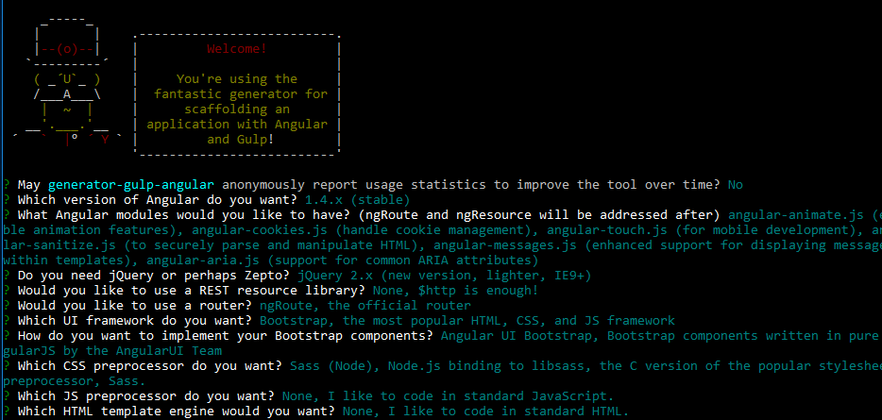
Create a Project
Generate a Scaffold Template (https://github.com/swiip/generator-gulp-angular)
Create a Directory mkdir weatherNg
Navigate to that Directory cd weatherNg
Start Scaffolding yo gulp-angular
Angular: 1.4.x (stable)
Modules (none)
JQuery (2.x)
Rest (none)
Router (ngRoute)
UI Framework (Bootstrap)
Angular UI
CSS Preprocessor (Sass Node)
JS Preprocessor (none)
HTML Template (none)

Slide 8
Build the Project
Install Project Dependencies with Bower
Bower Install bower install
Gulp Tasks
Gulp Build gulp build
Gulp Test gulp test
Gulp Serve gulp serve
Gulp Watch gulp watch
Setup is complete Now we can write Code

Slide 9




Lets look at the code
Use your web editor of choice (Some free ones below)
Visual Studio Code
Sublime Text
Brackets
Notepad++

Slide 10
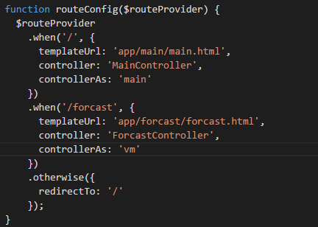
Adding a new route
The route tells the application what page to serve up based on the url path
The first parameter specifies the path that the route will register
templateUrl: specifies what template to use
controller: specifies which controller to use
controllerAs: specifies what the scope should be called
vm is a common controllerAs property and is short for “view model”
The otherwise section tells the app where to route if the path is not found
Snippet_01.js
Notes:
Snippet_01.js
.when('/forecast', {
templateUrl: 'app/forecast/forcast.html',
controller: 'ForecastController',
controllerAs: 'vm'
})
Using the route as a starting point we can see we need to add some files
- Add Forecast Directory
- Forecast Controller
- Forecast Template

Slide 11
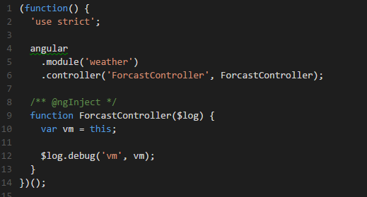
Adding a Controller
The controller will be responsible for the logic on the Forecast page
We register a new controller to our application (module)
controller: just a JavaScript Function
We set up a variable that will act as our scope and set it to this. The name of this variable should match the property you set for “controllerAs” in the previous step
ngInject does some magic for us by automatically setting up our dependency injection here we are injecting the angular $log service
https://docs.angularjs.org/guide/di
Snippet_02.js
Notes:
Snippet_02.js
(function() {
'use strict';
angular
.module('weather')
.controller('ForcastController', ForcastController);
/** @ngInject */
function ForcastController($log) {
var vm = this;
$log.debug('vm', vm);
}
})();

Slide 12
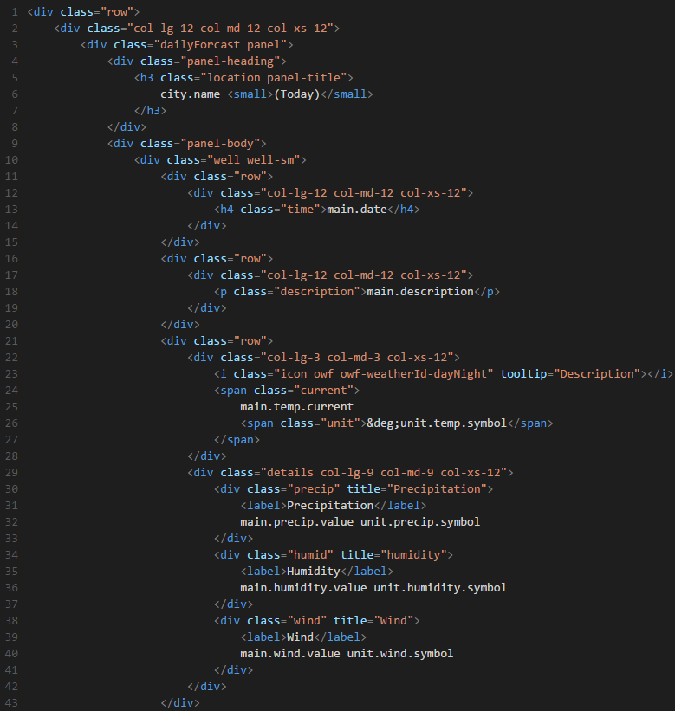
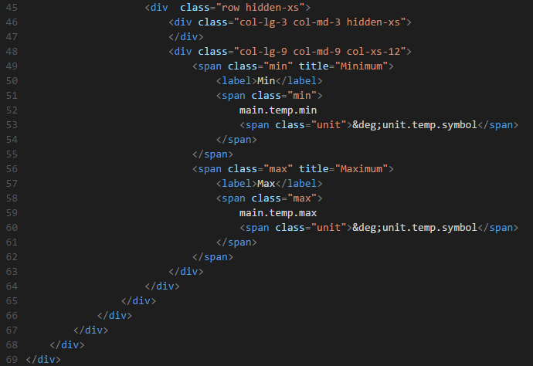
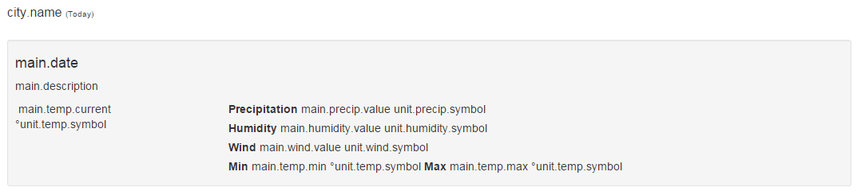
Adding a Template
The template will establish how our content is displayed, we will start with raw HTML and bootstrap
Snippet_03.html
Notes:
Snippet_03.html
<div class="row">
<div class="col-lg-12 col-md-12 col-xs-12">
<div class="dailyForcast panel">
<div class="panel-heading">
<h3 class="location panel-title">
city.name <small>(Today)</small>
</h3>
</div>
<div class="panel-body">
<div class="well well-sm">
<div class="row">
<div class="col-lg-12 col-md-12 col-xs-12">
<h4 class="time">main.date</h4>
</div>
</div>
<div class="row">
<div class="col-lg-12 col-md-12 col-xs-12">
<p class="description">main.description</p>
</div>
</div>
<div class="row">
<div class="col-lg-3 col-md-3 col-xs-12">
<i class="icon owf owf-weatherId-dayNight" tooltip="Description"></i>
<span class="current">
main.temp.current
<span class="unit">&deg;unit.temp.symbol</span>
</span>
</div>
<div class="details col-lg-9 col-md-9 col-xs-12">
<div class="precip" title="Precipitation">
<label>Precipitation</label>
main.precip.value unit.precip.symbol
</div>
<div class="humid" title="humidity">
<label>Humidity</label>
main.humidity.value unit.humidity.symbol
</div>
<div class="wind" title="Wind">
<label>Wind</label>
main.wind.value unit.wind.symbol
</div>
</div>
</div>
<div class="row hidden-xs">
<div class="col-lg-3 col-md-3 hidden-xs">
</div>
<div class="col-lg-9 col-md-9 col-xs-12">
<span class="min" title="Minimum">
<label>Min</label>
<span class="min">
main.temp.min
<span class="unit">&deg;unit.temp.symbol</span>
</span>
</span>
<span class="max" title="Maximum">
<label>Max</label>
<span class="max">
main.temp.max
<span class="unit">&deg;unit.temp.symbol</span>
</span>
</span>
</div>
</div>
</div>
</div>
</div>
</div>
</div>

Slide 13
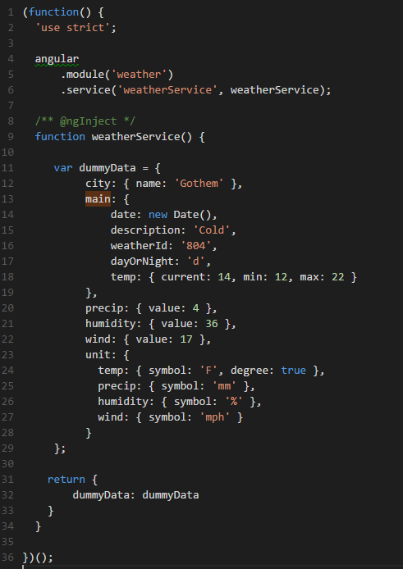
Adding a Service
A service is designed for manipulating data CRUD / REST
To start our service will serve up some dummy data, later we will request data from a external web service
The dummy data will feed the view and control what is displayed
More information on services can be found here: https://docs.angularjs.org/guide/services
Snippet_04.js
Notes:
Snippet_04.js
/* weather.service.js */
(function() {
'use strict';
angular
.module('weather')
.service('weatherService', weatherService);
/** @ngInject */
function weatherService() {
var dummyData = {
city: { name: 'Gothem' },
main: {
date: new Date(),
description: 'Cold',
weatherId: '804',
dayOrNight: 'd',
temp: { current: 14, min: 12, max: 22 }
},
precip: { value: 4 },
humidity: { value: 36 },
wind: { value: 17 },
unit: {
temp: { symbol: 'F', degree: true },
precip: { symbol: 'mm' },
humidity: { symbol: '%' },
wind: { symbol: 'mph' }
}
};
return {
dummyData: dummyData
}
}
})();

Slide 14
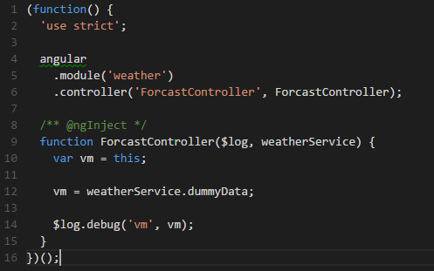
Calling our Service from a Controller
We will call our service from the forecast controller and it should log the information to the console.
Tell the controller about the service as seen on line 9
Call the exposed dummyData and set the view model to the dummyData
When you run your application you can now see the dummyData object in the console window.
Next we will bind the template to this view model
Snippet_05.js
Notes:
Snippet_05.js
(function() {
'use strict';
angular
.module('weather')
.controller('ForcastController', ForcastController);
/** @ngInject */
function ForcastController($log, weatherService) { //inject weatherService into the controller
var vm = this;
vm = weatherService.dummyData; // call our dummyData on the weatherService
$log.debug('vm', vm);
}
})();

Slide 15
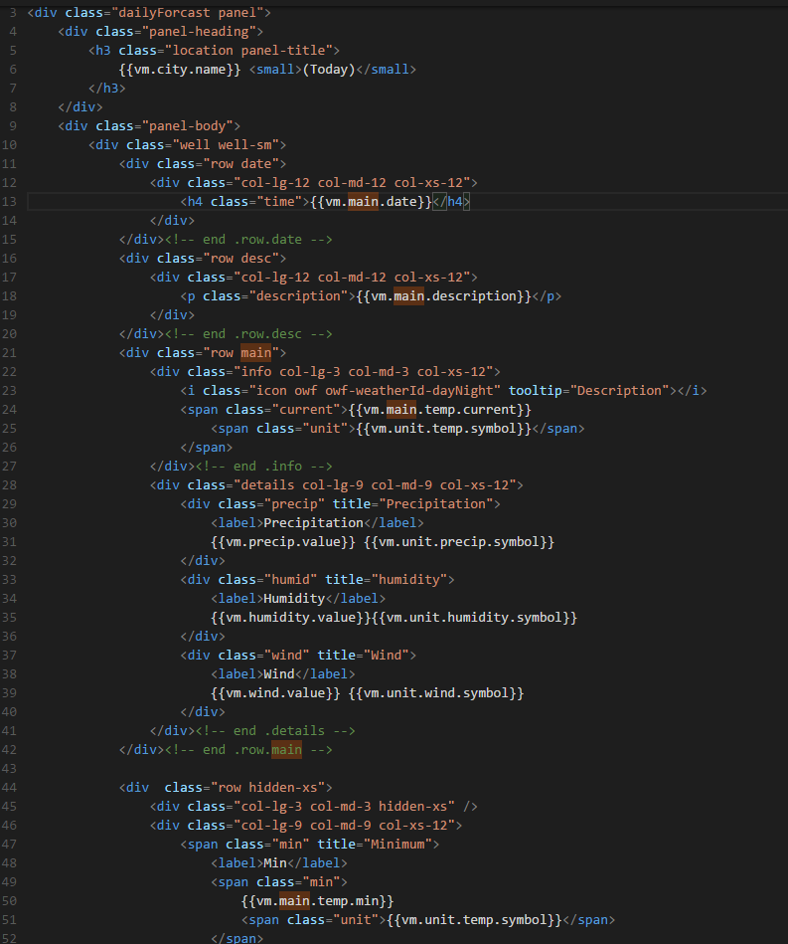
Binding our template to the View Model
We can do one way binding to our view model by calling our property inside double curly braces. {{vm.city.name}}
Using the console output as a guide replace the various references with bindings as you save you can see if you have bound the properties correctly
Don’t forget to bind the weather icon <i class="icon owf owf-{{vm.main.weatherId}}-{{vm.main.dayOrNight}}" tooltip="{{vm.main.description}}"></i>
Snippet_06.html
Notes:
Snippet_06.html
<!-- forecast.html -->
<div class="dailyForcast panel">
<div class="panel-heading">
<h3 class="location panel-title">
{{vm.city.name}} <small>(Today)</small>
</h3>
</div>
<div class="panel-body">
<div class="well well-sm">
<div class="row date">
<div class="col-lg-12 col-md-12 col-xs-12">
<h4 class="time">{{vm.main.date}}</h4>
</div>
</div><!-- end .row.date -->
<div class="row desc">
<div class="col-lg-12 col-md-12 col-xs-12">
<p class="description">{{vm.main.description}}</p>
</div>
</div><!-- end .row.desc -->
<div class="row main">
<div class="info col-lg-3 col-md-3 col-xs-12">
<i class="icon owf owf-{{vm.main.weatherId}}-{{vm.main.dayOrNight}}" tooltip="{{vm.main.description}}"></i>
<span class="current">{{vm.main.temp.current}}
<span class="unit">{{vm.unit.temp.symbol}}</span>
</span>
</div><!-- end .info -->
<div class="details col-lg-9 col-md-9 col-xs-12">
<div class="precip" title="Precipitation">
<label>Precipitation</label>
{{vm.precip.value}} {{vm.unit.precip.symbol}}
</div>
<div class="humid" title="humidity">
<label>Humidity</label>
{{vm.humidity.value}}{{vm.unit.humidity.symbol}}
</div>
<div class="wind" title="Wind">
<label>Wind</label>
{{vm.wind.value}} {{vm.unit.wind.symbol}}
</div>
</div><!-- end .details -->
</div><!-- end .row.main -->
<div class="row hidden-xs">
<div class="col-lg-3 col-md-3 hidden-xs" />
<div class="col-lg-9 col-md-9 col-xs-12">
<span class="min" title="Minimum">
<label>Min</label>
<span class="min">
{{vm.main.temp.min}}
<span class="unit">{{vm.unit.temp.symbol}}</span>
</span>
</span>
<span class="max" title="Maximum">
<label>Max</label>
<span class="max">
{{vm.main.temp.max}}
<span class="unit">{{vm.unit.temp.symbol}}</span>
</span>
</span>
</div>
</div><!-- end .hidden-xs -->
</div><!-- end .well -->
</div><!-- end .panel-body -->
</div><!-- end .dailyForcast.panel -->

Slide 16

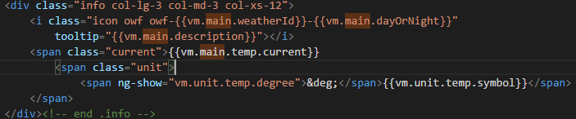
Using Built in Filters and Directives
Filters Allow us to format the value of an expression. Lets use a filter on our date object to display the day of the week. Use this link as a reference: https://docs.angularjs.org/api/ng/filter/date
Directives are markers on a DOM element that tell Angular to compile and attach a specified behavior to that Dom Element. Some Examples include: (ng-show, ng-hide, ng-class, and ng-model)
Using a directive decide to show or hide a DOM element to display the degrees symbol before the unit.temp.symbols (Note that the HTML encoding for the degree symbol is &deg;)
Apply this logic to the min and max temp as well
Snippet_06.html
Notes:
Snippet_07.html
<!-- forecast.html -->
<div class="dailyForcast panel">
<div class="panel-heading">
<h3 class="location panel-title">
{{vm.city.name}} <small>(Today)</small>
</h3>
</div>
<div class="panel-body">
<div class="well well-sm">
<div class="row date">
<div class="col-lg-12 col-md-12 col-xs-12">
<h4 class="time">{{vm.main.date | date:'EEEE'}}</h4>
</div>
</div><!-- end .row.date -->
<div class="row desc">
<div class="col-lg-12 col-md-12 col-xs-12">
<p class="description">{{vm.main.description}}</p>
</div>
</div><!-- end .row.desc -->
<div class="row main">
<div class="info col-lg-3 col-md-3 col-xs-12">
<i class="icon owf owf-{{vm.main.weatherId}}-{{vm.main.dayOrNight}}" tooltip="{{vm.main.description}}"></i>
<span class="current">{{vm.main.temp.current}}
<span class="unit"><span ng-show="vm.unit.temp.degree">&deg;</span>{{vm.unit.temp.symbol}}</span>
</span>
</div><!-- end .info -->
<div class="details col-lg-9 col-md-9 col-xs-12">
<div class="precip" title="Precipitation">
<label>Precipitation</label>
{{vm.precip.value}} {{vm.unit.precip.symbol}}
</div>
<div class="humid" title="humidity">
<label>Humidity</label>
{{vm.humidity.value}}{{vm.unit.humidity.symbol}}
</div>
<div class="wind" title="Wind">
<label>Wind</label>
{{vm.wind.value}} {{vm.unit.wind.symbol}}
</div>
</div><!-- end .details -->
</div><!-- end .row.main -->
<div class="row hidden-xs">
<div class="col-lg-3 col-md-3 hidden-xs" />
<div class="col-lg-9 col-md-9 col-xs-12">
<span class="min" title="Minimum">
<label>Min</label>
<span class="min">
{{vm.main.temp.min}}
<span class="unit"><span ng-show="vm.unit.temp.degree">&deg;</span>{{vm.unit.temp.symbol}}</span>
</span>
</span>
<span class="max" title="Maximum">
<label>Max</label>
<span class="max">
{{vm.main.temp.max}}
<span class="unit"><span ng-show="vm.unit.temp.degree">&deg;</span>{{vm.unit.temp.symbol}}</span>
</span>
</span>
</div>
</div><!-- end .hidden-xs -->
</div><!-- end .well -->
</div><!-- end .panel-body -->
</div><!-- end .dailyForcast.panel -->

